Slide 1
Future tax leaders Form 990 and IRS updates
February 23, 2023
EY Exempt Organization Tax Services

Slide 2
Disclaimer
EY refers to the global organization, and may refer to one or more, of the member firms of Ernst & Young Global Limited, each of which is a separate legal entity. Ernst & Young LLP is a client-serving member firm of Ernst & Young Global Limited operating in the US.
This presentation is © 2023 Ernst & Young LLP. All rights reserved. No part of this document may be reproduced, transmitted or otherwise distributed in any form or by any means, electronic or mechanical, including by photocopying, facsimile transmission, recording, rekeying, or using any information storage and retrieval system, without written permission from Ernst & Young LLP. Any reproduction, transmission or distribution of this form or any of the material herein is prohibited and is in violation of US and international law. Ernst & Young LLP expressly disclaims any liability in connection with use of this presentation or its contents by any third party.
Views expressed in this presentation are those of the speakers and do not necessarily represent the views of Ernst & Young LLP.
This presentation is provided solely for the purpose of enhancing knowledge on tax matters. It does not provide accounting, tax or other professional advice because it does not take into account any specific taxpayer’s facts and circumstances.
Neither EY nor any member firm thereof shall bear any responsibility whatsoever for the content, accuracy or security of any third-party websites that are linked (by way of hyperlink or otherwise) in this presentation.

Slide 3
Presenters
Steve Clarke
Managing Director
Exempt Organization Tax Services
Ernst & Young LLP
Washington, DC
Melanie McPeak
Senior Manager
Exempt Organization Tax Services
Ernst & Young LLP
Tampa, FL
Austin Bailey
Manager
Exempt Organization Tax Services
Ernst & Young LLP
Pittsburgh, PA
Cal Hoke
Senior
Exempt Organization Tax Services
Ernst & Young LLP
Raleigh, NC

Slide 4
Objectives
After successful completion of this course, participants should be able to:
Explain activity within IRS Tax Exempt and Government Entities Division (TE/GE)
Recognize the electronic filing IRS processing challenges for the Form 990 series
Identify significant changes to the 2022 Forms 990, 990-T and instructions:
Describe the implications of the changes for tax-exempt organizations
Discuss the changes to Form 4720
Identify the implications of community benefit report to Congress and Schedule H filings
Identify the implications of supporting organizations and Schedule A filings

Slide 5
Agenda
IRS update
Electronic filing and IRS processing challenges
2022 Form 990 significant changes
2022 Form 990-T significant changes
2022 Form 4720 significant changes
Form 990, Schedule H
Supporting organizations and Schedule A filings
Tax updates: year in review

Slide 6
Section divider over two lines or three lines
IRS update
Page 5
EY exempt organization tax services future tax leaders program

Slide 7
IRS Tax Exempt and Government Entities Division
Employee plans
Exempt Organizations and Government Entities (EO/GE):
Federal, state and local governments
Indian tribal governments
Tax-exempt bonds
Exempt organizations:
Rulings and Agreements
Examinations

Slide 8
IRS TE/GE’s FY 2022 accomplishments letter EO accomplishments
New leadership team:
Longtime Commissioner Sunita Lough retired, and Edward Killen took over the role (October 2022)
501(r) reviews of tax-exempt hospitals:
1,260 conducted in fiscal year 2022
67 hospitals referred for exam
Most common issues included:
Lack of community health needs assessment — 501(r)(3)
Financial assistance policies — 501(r)(4)
TE/GE sector snapshot — tax-exempt organizations:
Employ almost 29% of the American workforce
Control nearly $53 trillion in assets
Account for about 26% of nearly $1.5 trillion in federal tax ”expenditures” (revenue losses from tax exemption and related provisions)

Slide 9
IRS TE/GE’s FY 2022 accomplishments letter EO accomplishments
Started 3,009 examinations:
711 data driven
2,091 referrals, claims and other casework
207 compliance strategies
Completed examinations of 3,425 filings:
938 data-driven
2,012 referrals, claims and other casework
475 compliance strategies
Most prominent issues: employment taxes, operational requirements and self-dealing
Received over 100,000 determination applications:
Nearly 80,000 Forms 1023-EZ
Closed 136,708 applications
119,926 approvals/113,850 approvals for 501(c)(3) status
Continued compliance checks with focus on:
Hospital organizations filing Form 990-T with expenses materially exceeding gross income
For-profit successors, private benefit and inurement and 501(c)(7) entities
Slight decrease in TE/GE employees, for total of 1,513:
About 530 employees in Exempt Organizations

Slide 10
IRS TE/GE’s FY 2021 accomplishments letter EO accomplishments
501(r) reviews of tax-exempt hospitals:
1,019 conducted in fiscal year 2021
71 hospitals referred for exam
Started 3,681 examinations:
948 data driven
2,167 referrals, claims and other casework
566 compliance strategies
Completed examinations of 3,249 returns:
1,035 data driven
1,684 referrals, claims and other casework
530 compliance strategies
Most prominent issues: miscellaneous excise taxes, unrelated business taxable income (UBTI), filing requirements and operational requirements
Received over 100,000 determination applications:
Nearly 70,000 Forms 1023-EZ
Closed 94,466 applications
81,589 approvals/76,852 approvals for 501(c)(3) status
Continued compliance checks and exams:
Compliance checks: Hospital organizations filing Form 990-T with expenses materially exceeding gross income
Compliance exams: Indicators of private benefit/inurement involving officer business partnerships, underreported credit card income and related employees in for-profit partnerships
Nearly a 5.1% decrease in TE/GE employees, for total of 1,521, about 530 employees in Exempt Organizations

Slide 11
IRS Exempt Organizations update From IRS Exempt Organizations and Government Entities (EO/GE) Director Robert Malone, October 24, 2022
UBTI liability compliance project — of hospitals reporting net UBTI losses:
Examined how tax-exempt hospitals allocated expenses to offset gross UBTI
Examined whether tax-exempt hospitals with continuous net losses from unrelated business activities had a profit motive in conducting those activities
EO/GE began 10 exams of tax-exempt hospitals on these UBTI issues in FY22 and closed 18 UBTI-related exams of hospitals that began in prior years, with an 89% change rate
Since this project began in 2019, EO/GE has closed 69 of these hospital UBTI-related exams, with a 33% change rate
Section 4960 excess compensation excise tax compliance checks: EO/GE began 840 compliance checks in FY22, 100 referred for examination
Most prevalent issues from referrals and other case work stemmed from COVID-19-related claims and IRC Section 4980H (employers’ shared responsibility for health coverage)

Slide 12
IRS Exempt Organizations update From IRS Exempt Organizations and Government Entities (EO/GE) Director Robert Malone, October 24, 2022
Annual Affordable Care Act-mandated reviews of tax-exempt hospitals’ community benefit (which IRS has also leveraged to conduct IRC 501(r) compliance reviews) have resulted in:
59 new examinations of tax-exempt hospitals and 58 closed examinations in FY22, with a 60% change rate
103 new compliance checks in FY22, primarily of hospitals’ financial assistance policies, and 128 closed compliance checks
FY23 EO/GE projects include training agents on the siloing rules for IRC Section 512(a)(6) unrelated business income tax (i.e., computing UBTI separately for each separate unrelated trade or business):
512(a)(6)-related examinations and/or compliance checks likely to follow

Slide 13
IRS TE/GE compliance strategies
Compliance strategies are used to identify priority compliance issues and to allocate resources. Current compliance strategies addressed include:
Hospital organizations with UBTI:
Focus on UBTI reported on Form 990-T, Exempt Organization Business Income Tax Return, where expenses materially exceed gross income
Former for-profit organizations:
Organizations formerly operated as for-profit entities prior to their conversion to Section 501(c)(3) organizations
For fiscal year 2022, IRS TE/GE completed 475 compliance strategy examinations, with an 85.9% change rate.

Slide 14
IRS TE/GE data-driven approaches
TE/GE and EO employ data-driven approaches to identifying organizations to examine:
Use procedures and models to analyze data from returns and other historical information to identify areas of noncompliance
Current priorities in data-driven approaches include:
Query sets/models for:
Form 990
Form 990-EZ
Form 990-PF
Form 5227
Collaboration with research, applied analytics and statistics (RAAS)
For fiscal year 2022, IRS TE/GE completed 938 data-driven examinations, with an 84.4% change rate.
Notes:
For FY 2020 the IRS TE/GE completed 508 data driven examinations — this year it is up to 1,035 as noted in the slide.

Slide 15
IRS TE/GE referrals, claims and casework
Referrals:
Receives referrals from sources both inside and outside the IRS that allege noncompliance by exempt organizations
Claims:
Handles claims from tax-exempt organizations requesting refunds or credits of overpayments of amounts already assessed and paid:
Including tax, penalties, interest, or adjustments of tax paid or credits not previously reported or allowed
Casework:
Hospital examinations and compliance checks initiated by referrals from triannual community benefit and 501(r) reviews:
Section 9007(c) of the Affordable Care Act (ACA) requires the IRS to review, once every three years, community benefit activities of each tax-exempt hospital.
IRS has leveraged these community benefit reviews to review compliance with Section 501(r).
Most prominent issues found involve temporary workstreams related to repeal of Section 512(a)(7) and COVID-19-related employee retention credit claims.
For fiscal year 2022, IRS TE/GE completed 2,012 referrals, claims and other casework examinations, with a 72.8% change rate.
Notes:
For FY 2020 the IRS TE/GE completed 1,358 referrals, claims and other casework examinations — this year it is up to 1,684 as noted in the slide.

Slide 16
IRS TE/GE compliance checks
TE/GE and EO use “compliance checks” or “soft letters” to address potential noncompliance.
A compliance check is non-examination correspondence with an organization to either:
Ask about an item on a filed return
Determine whether reporting requirements have been met
Assess whether an organization’s activities are consistent with its tax-exempt purpose
A soft letter notifies an organization of a change in law or a compliance issue; responses are not expected but, if received, may be converted into a compliance check.
Examples of compliance checks:
Entities that were required to file but failed to file Form 990-T
Hospital organizations that did not comply with the Section 501(r) financial assistance policy requirements
Section 4960 tax on entities reporting compensation under on Part VII greater than $1 million without Form 4720 on file

Slide 17
Items to note from FY23 TE/GE program letter
The FY23 TE/GE program letter continues to be only two pages and includes general compliance goals and priorities, including:
Examine organizations and entities using referrals and data analytics to focus on high-risk issues
Collaborate with Criminal Investigation (CI); Large Business and International Division (LB&I); Small Business/Self-Employed Division (SB/SE); and Office of Research, Applied Analytics and Statistics (RAAS) in selecting and examining returns
Expand the use of data, machine learning and artificial intelligence algorithms to select returns for exam

Slide 18
IRS TE/GE compliance programs and priorities
The IRS has a separate web page for tax-exempt and government-entity “compliance programs and priorities.” The page states the IRS will continue to pursue the compliance programs described in prior TE/GE program letters:
See Tax Exempt & Government Entities — Compliance Program and Priorities
The web page also lists current compliance strategies for FY23, including strategies for examination of:
Excise tax on excess compensation (Section 4960) — Form 990 filers that reported paying compensation over $1 million to at least one covered employee but did not file Form 4720 to report or pay the excise tax
Form 990-N filers with gross receipts over $50,000
Worker classification — to determine whether organizations are incorrectly reporting employees as independent contractors

Slide 19
Polling question 1
There were fewer TE/GE examinations started in 2022 than in 2021:
A
True
B
False
Notes:
True

Slide 20
Section divider over two lines or three lines
Electronic filing and IRS processing challenges
Page 19
EY exempt organization tax services future tax leaders program

Slide 21
Electronic filing requirements
The Taxpayer First Act, enacted July 1, 2019, requires tax-exempt organizations to electronically file information returns and related forms, including, but not limited to:
Form 990 series, Form 4720 (must be e-filed by private foundations), Form 8868, Form 1120 POL, Forms 1023 and 1023-EZ, and Forms 1024 and 1024A
Can submit Forms 1023, 1024, 2848 and 8821 online
The IRS no longer accepts paper-filed returns required to be filed electronically and rejects electronically filed returns when they are materially incomplete or the wrong return.
Modernized e-file (MeF) providers can be found at Tax Year 2021 Exempt Organizations Modernized e-File (MeF) Providers.

Slide 22
IRS processing challenges
Due to the IRS’s e-filing requirements, a few issues may arise when submitting returns:
Business Master File (BMF):
May reject BMF submissions if the information on the filing does not match the IRS Business Master File
Cases of the IRS changing the BMF without the instruction of exempt organizations or failing to change the BMF as requested by exempt organizations
EY tax alert on BMF issues: TE/GE director suggests contacting the IRS for corrections
Rejections related to Section 4960 excise tax on excess compensation:
Rejection of 4720 filings for affiliated for-profits
Group ruling roster:
IRS may misclassify the foundation status of an entity’s subordinates.
This issue may impact the ability of organizations to receive contributions from donors.
Notes:
Vocally communicate client examples when discussing this slide

Slide 23
Electronic payments
Taxpayers may not pay taxes via check or money order. Generally, an organization will pay through electronic funds transfer (EFT) using the Electronic Federal Tax Payment System (EFTPS):
If you don't want to use EFTPS, you can arrange for your tax professional, financial institution, payroll service or other trusted third party to make electronic deposits on your behalf.
To get more information or to enroll in EFTPS, go to EFTPS.gov or call +1 800 555 4477 or +1 800 733 4829 (TTY/TDD). Additional information about EFTPS is also available in Publication 966.

Slide 24
Public access to searchable Form 990 data
The IRS has made Forms 990 and 990-T available on Tax Exempt Organization Search:
All confidential information (e.g., donor information, SSNs) redacted by IRS
Includes all e-filed returns since 2011
Does not include attachments in non-XML format
Allows sorting, analysis and comparison of 990 data of different organizations and subsectors of exempt organizations
Benchmarking:
The availability of XML allows for easy access to benchmarking data so entities can compare different metrics to that of their peers:
For example: A comparison of Part VII compensation data and/or Schedule H community benefit levels vs. that of 990 filer’s peer group

Slide 25
Form 990-related interactions with the IRS
IRS examinations, compliance checks and notices based on Form 990 and 990-T data
Compliance checks for apparent Section 4960 liability
Compliance checks for apparent 501(r) non-compliance
Examinations of hospitals that report continuous UBTI losses but pay no unrelated business income tax
Delinquency notices for failure to file timely, complete and/or accurate return
Section 6652 penalties: $100 a day, maximum $50,000 a year
Penalties may be abated for reasonable cause
May request public disclosure copies of Forms 990 from the IRS by submitting Form 4506-A
Exemption auto-revocation notice for failure to file three consecutive Form 990 series returns
Fax number to request corrections of erroneous auto-revocation: +1 855 247 6123
IRS TE/GE Exempt Organizations customer service number:
+1 877 829 5500

Slide 26
Polling question 2
Describe the level of difficulty of e-filing your organization’s most recent Form 990-T:
A
Easy
B
Moderate
C
Excessive
D
N/A (e.g., EY employee, didn’t file 990-T)

Slide 27
Section divider over two lines or three lines
2022 Form 990
significant changes
Page 26
EY exempt organization tax services future tax leaders program

Slide 28
2022 Form 990 instructions changes
What’s new:
Short period filings are now eligible for e-filing, consistent with the Taxpayer First Act and the IRS’s efforts to streamline the filing process.
Change in accounting period filings will need to include a reason for the change:
Organizations will need to add detail within their tax preparation software before submitting for e-file.
Part V, line 17 (asking whether Section 501(c)(21) black lung trust incurred Sections 4951–4953 excise tax during year):
The instructions now clarify when the organization should answer “Yes.”
The IRS has removed tips on how to report COVID-19-related program revenue and expenses.

Slide 29
2022 Form 990
Exempt organizations are no longer afforded penalty relief for certain compensation paid to a management company under Announcement 2001-33
Ann. 2001-33 allowed 990 filers that paid third parties (e.g., management service companies) for the services of officers, directors, or key employees to report the compensation as being paid to the third party rather than to the officer, director or key employees
Announcement 2021-18 – revoked Ann. 2001-33, requiring exempt organizations to follow the specific instructions for Form 990
Form 990 now uses federal common law employment rules to determine whether payments to a third party for services of officers, directors and/or employees should be reported as payments to the third party or the officers, directors, and/or employees
The Single Audit Act of 1984 and OMB Circular A-133 are superseded by Uniform Guidance, 2 C.F.R. Part 200, Subpart F, which now requires states, local governments, and nonprofit organizations that spend $750,000 (previously $500,000) or more of federal awards in a year to obtain an annual audit.

Slide 30
Polling question 3
Form 990 filers must always report payments to third parties for services as officers as compensation to those officers:
A
True
B
False
Notes:
True

Slide 31
Section divider over two lines or three lines
2022 Form 990-T
significant changes
Page 30
EY exempt organization tax services future tax leaders program

Slide 32
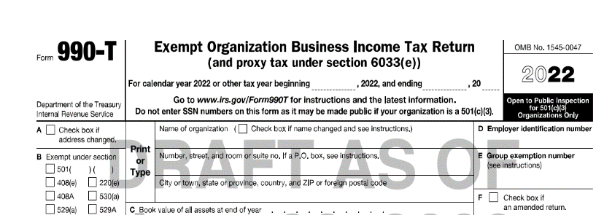
Form 990-T and 512(a)(6)
Section 512(a)(6) regulations:
UBTI from each separate unrelated trade or business, or “silo,” under IRC Section 512(a)(6) must be calculated separately in preparing the Form 990-T and its supporting workpapers.
Final regulations apply to tax years beginning on or after December 2, 2020. This means that, generally, the final regulations are applicable for the 2022 Forms 990-T.
Tax alert on the final regs: Final regulations on unrelated trades or businesses affect tax-exempt organizations, as well as asset managers with exempt organizations as investors (ey.com).
Notes:
If an organization is eligible to submit the 990N or 990ez and chooses to file the Form 990, it must file a complete return. (with all schedules)
Gross receipts are the total amounts the organization received from all sources during its tax year, without subtracting any costs or expenses.

Slide 33
2022 Form 990-T reminders and form change
Form 990-T mandatory electronic filing:
Effective February 2021
Temporary allowance of 100% for business meals:
Organizations are allowed a 100% deduction for certain business meal expenses paid or incurred in 2021 and 2022.
Line G added a checkbox for state college/university to select when filing.

Slide 34
2022 Form 990-T instructions changes (draft)
What’s new?
New tax credits available:
Advanced manufacturing investment credit — filer that takes credit is treated as making payment against tax on Form 990-T
Inflation Reduction Act clean energy investment and production credits — allowed as general business credits on Form 990-T
NAICS (North American Industry Classification System) codes were revised in 2022 — see North American Industry Classification System (NAICS) U.S. Census Bureau.
Inflation Reduction Act imposed the corporate alternative minimum tax (CAMT) under Section 55, effective for tax years beginning after 2022:
Applies to “applicable corporations” under Section 59(k)

Slide 35
2022 Form 990-T page 2 Net operating losses
Part IV, lines 4 and 5 require taxpayers to track:
Post-2017 UBTI net operating loss (NOL) carryovers for each separate unrelated business can only offset UBTI from that same unrelated business. These NOLs are subject to the Section 512(a)(6) rules:
For 2022 the 80% income limitation will apply for NOLs generated post-2017; however, they can still be carried forward indefinitely.
Pre-2018 NOL carryovers can offset UBTI from any unrelated business and are not subject to the 512(a)(6) rules:
NOLs generated pre-2018 are not subject to the 80% limitation and can be carried forward up to 20 years.
Organizations with both pre-2018 and post-2017 NOLs are required to deduct the pre-2018 NOLs before applying any post-2017 NOLs.

Slide 36
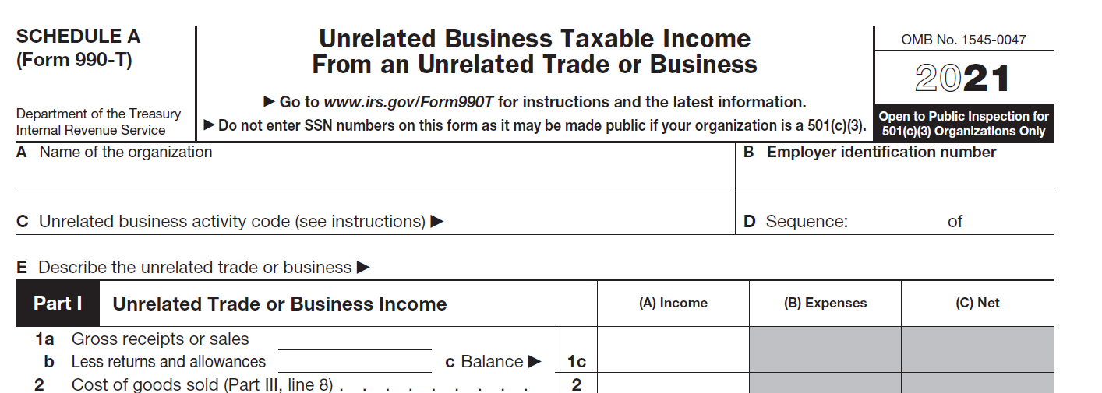
2022 Form 990-T, Schedule A
Form 990-T:
Schedule A reflects IRC Section 512(a)(6) regulations:
Report NAICS two-digit code that most accurately describes each unrelated trade or business:
The code should be followed by four zeros, as the IRS e-filing program requires six digits in this field.
If multiple Schedule As are filed for separate unrelated trades or businesses, assign sequential numbers to each Schedule A and list that number on line D (e.g., Sequence: 1 of 5).
Deductions for NOLs arising in tax years beginning on or after January 1, 2018, are reported separately on each Schedule A rather than in the aggregate.
Notes:
No changes from 2020 to 2022, discuss purpose of sch A and operations.

Slide 37
Polling question 4
My organization had total gross UBTI of $10,000 for tax year 2022 but no net UBTI. Because my organization had no net UBTI for 2022, it does not need to file a Form 990-T for tax year 2022:
A
True
B
False
Notes:
True

Slide 38
Section divider over two lines or three lines
2022 Form 4720
significant changes
Page 37
EY exempt organization tax services future tax leaders program

Slide 39
Form 4720 in general
Form 4720, Return of Certain Excise Taxes Under Chapters 41 and 42 of the Internal Revenue Code, must be filed to report and pay the excise tax on any excess benefit transaction.
Form 990, Part V, line 15:
“Is the organization subject to the section 4960 tax on payment(s) of more than $1,000,000 in remuneration or excess parachute payment(s) during the year? If ‘Yes,’ see instructions and file Form 4720, Schedule N.”
The IRS is sending compliance checks to Form 990 filers that report paying over $1 million in compensation to one or more officers or other employees but do not file a Form 4720 to report and pay excise tax on such compensation.
Notes:
An applicable tax-exempt organization (ATEO) and its related organizations (similar to Form 990 definition of “related organization”) are liable for a 21% excise tax on:
Remuneration over $1m in a calendar year (2018 and forward) paid to a “covered employee”
An “excess parachute payment” (for involuntary severance) that exceeds three times the five-year average base pay generally
An ATEO’s covered employees are its five highest-compensated employees (aggregating compensation from related organizations) for each calendar year 2017 and forward.
The Section 4960 excise tax liability is shared pro rata among the ATEO and its related organizations.
Those on an ATEO’s list of “covered employees” remain on its list even after leaving the ATEO’s employment.
“Remuneration,” for purposes of calculating both the top five highest-compensated employees each year and the amounts subject to the Section 4960 excise tax, is defined similarly but not identical to Form 990 “compensation.”

Slide 40
2022 updates and areas of focus
2022 instructions add more emphasis and clarification on Section 4960 compensation excise tax reporting:
Filing organization should only report its own excise tax information in Parts I and III — not that of any related person/organization.
Each related person liable for the compensation excise tax must file a Form 4720 separate from that filed by the applicable tax-exempt organization to pay its ratable share of the tax.
An individual or entity may be liable for both the 4960 compensation excise tax and an excise tax for either self-dealing (Section 4941) or excess benefit (Section 4948) for the same compensation.
Private foundations cannot paper file Form 4720; however, public charities can still paper file the Form.
Private foundations may not pay a disqualified person’s excise tax
Such payment would be prohibited self-dealing under Section 4941.
IRS added new paragraph and heading to highlight and clarify how to report self-dealing and excess benefit transactions.
Notes:
An applicable tax-exempt organization (ATEO) and its related organizations (similar to Form 990 definition of “related organization”) are liable for a 21% excise tax on:
Remuneration over $1m in a calendar year (2018 and forward) paid to a “covered employee”
An “excess parachute payment” (for involuntary severance) that exceeds three times the five-year average base pay generally
An ATEO’s covered employees are its five highest-compensated employees (aggregating compensation from related organizations) for each calendar year 2017 and forward.
The Section 4960 excise tax liability is shared pro rata among the ATEO and its related organizations.
Those on an ATEO’s list of “covered employees” remain on its list even after leaving the ATEO’s employment.
“Remuneration,” for purposes of calculating both the top five highest-compensated employees each year and the amounts subject to the Section 4960 excise tax, is defined similarly but not identical to Form 990 “compensation.”

Slide 41
2022 Form 4720 changes to form and instructions
2022 Form 4720, which may be filed electronically by public charities, is required to be filed electronically by private foundations.
Line B requires filer to provide a list showing the name and EIN (employer identification number) for each organization for which it is required to file a Form 4720 in the current tax year.

Slide 42
Polling question 5
The IRS is sending compliance checks to Form 990 filers that report paying over $1 million in compensation to one or more officers or other employees but do not file Form 4720 to report compensation excise tax:
A
True
B
False
Notes:
True

Slide 43
Section divider over two lines or three lines
Form 990, Schedule H
Page 42
EY exempt organization tax services future tax leaders program

Slide 44
IRS Form 990, Schedule H instructions — 2022 changes
Part II, Community Building Activities:
Instructions clarify that some community building activities may meet the definition of a community health improvement service, as defined in Worksheet 4.
Instructions continue to state that community building costs that are reported as community health improvement service costs in Part I should not be reported as community building costs in Part II.
Part I, Financial Assistance and Certain Other Community Benefits at Cost:
Deleted instruction: “See the instructions to the worksheets for definitions of the various types of community benefit (for example, community health improvement services, health professions education, subsidized health services, research, etc.) to be reported on lines 7a through 7k.”
Worksheets for Part I, line 7:
“Optional” removed from the heading, although the body of the instructions maintains that using the worksheets is not required.

Slide 45
IRS community benefit reports to Congress
Affordable Care Act requires the IRS and the U.S. Department of Health & Human Services (HHS) to annually report to Congress on community benefit provided by tax-exempt, taxable and government hospitals.
IRS has reported that, on average, Section 501(c)(3) hospitals attributed between 8.84% and 9.84% of their total expenses to community benefit:
Total community benefit is derived from Form 990, Schedule H.
No comparisons are available to taxable and government hospitals’ total community benefit.
According to the IRS, on average, Section 501(c)(3) hospitals attributed between 1.62% and 2.22% of their total expenses to charity care (vs. between 1.31% and 2.62% for taxable hospitals):
Comparison of charity care is based on uncompensated care data derived from Medicare cost report, Worksheet S-10.

Slide 46
IRS report to Congress on community benefit (2020)
Based on 2016 Centers for Medicare & Medicaid Services (CMS) and Form 990, Schedule H data
Charity care provided, based on CMS data:
Taxable hospitals: 2.62% of total expenses
Tax-exempt hospitals: 2.05% of total expenses
Government hospitals: 3.65% of total expenses
Unreimbursed costs for services provided by means-tested programs, based on CMS data:
Taxable hospitals: 2.22% of total expenses
Tax-exempt hospitals: 3.38% of total expenses
Government hospitals: 3.44% of total expenses
Total community benefit expenses provided by tax-exempt hospitals, based on Schedule H data: 9.42% of total expenses

Slide 47
Government Accountability Office community benefit report
The Government Accountability Office (GAO), in its report on IRS oversight of tax-exempt hospitals (September 2020), recommended that:
Congress should specify in the Internal Revenue Code what services and activities constitute sufficient community benefit:
Status: open (as of November 2022)
The IRS should update Schedule H to promote more clear, consistent and comprehensive community benefit reporting:
Status: open (as of November 2022)
The IRS should consider asking tax-exempt hospitals to report community benefit on Schedule H by facility, rather than by collective organization:
Status: closed in June 2022 (IRS declined to implement this recommendation, because exemption is granted at the organizational level, so such reporting would have no tax administration benefit)
The IRS should establish a process for identifying hospitals at risk for noncompliance with the community benefit standard:
Status: closed (IRS updated guidance for reviews under Affordable Care Act (ACA) Hospital Review group)
The IRS should establish specific audit codes for identifying potential noncompliance with the community benefit standard:
Status: closed (IRS established a new code for community benefit standard noncompliance)

Slide 48
Polling question 6
Do you expect to spend more or less time on Schedule H this year:
A
More
B
Less
C
N/A (e.g., EY employee)

Slide 49
Section divider over two lines or three lines
Supporting organizations and Schedule A filings
Page 48
EY Exempt Organization Tax Services future tax leaders program

Slide 50
Classifications
IRC §501(c)(3) organizations by default are classified as private foundations unless they qualify as a public charities.
Purpose of Schedule A is to demonstrate how a filer qualifies as a public charity.
Public charities:
Public institutions:
§170(b)(1)(A)(i) — church, convention or association of churches and integrated auxiliaries of churches
§170(b)(1)(A)(ii) — school or educational organization
§170(b)(1)(A)(iii) — hospital or medical research organization
§170(b)(1)(A)(iv) — entity operated to benefit a college owned or operated by a governmental unit
§170(b)(1)(A)(v) — governmental unit
Publicly supported organizations:
Donative-type public charity — §509(a)(1) and §170(b)(1)(A)(vi)
Service provider-type public charity — §509(a)(2)
Supporting organizations (§509(a)(3)):
Type I — controlled or supervised by one or more supported organizations
Type II — operated by one or more supported organizations
Type III — operated in connection with one or more supported organizations
Notes:
Requires organization to provide necessary information about its public charity status, to prove that it should not be deemed a private foundation.

Slide 51
Public support tests: Section 509(a)(1)/Section 170(b)(1)(A)(vi) and Section 509(a)(2)
For an organization to qualify as a publicly supported organization, it must pass one of two public support tests:
§509(a)(1)/§170(b)(1)(A)(vi):
At least one-third of support over the prior five tax years is from the general public:
2% threshold for inclusion of contributions from single donor and that donor’s family members, in the aggregate
2% threshold does not apply to §170(b)(1)(A)(vi) entities and government units
§509(a)(2):
At least one-third of support over the prior five tax years is contributions and gross receipts from related activities:
1% ceiling for inclusion of contributions from single donor and that donor’s family members, in the aggregate, during a given tax year
This 1% ceiling also applies to §170(b)(1)(A)(vi) entities and government units
Not more than one-third of support is from the sum of:
Investment income
Unrelated business taxable income, less amount of unrelated business income tax paid

Slide 52
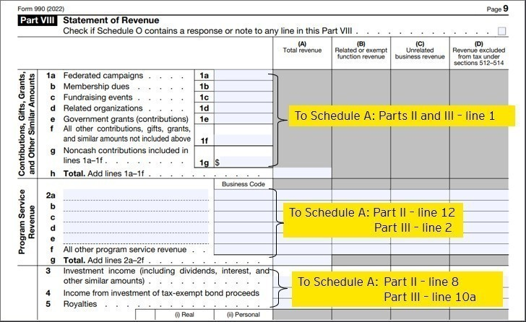
Schedule A reporting

Slide 53
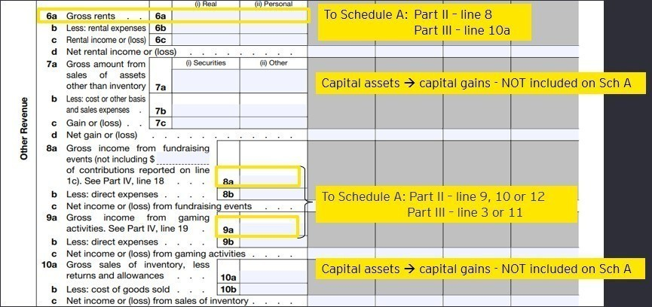
Schedule A reporting

Slide 54
Polling question 7
Which of the following is a publicly supported organization:
A
509(a)(1)/170(b)(1)(A)(vi) charity
B
Section 509(a)(2) charity
C
Section 509(a)(3) supporting organization
D
Both A and B
D
None of the above
Notes:
Answer::D

Slide 55
Meeting and failing public support test – timekeeping and other considerations
The period for determining whether an organization meets either the § 509(a)(1)/ § 170(b)(1)(A)(vi) or § 509(a)(2)) public support test is its past five tax years
Starting with its first five tax years; it is deemed to meet the test over its first five years.
Short tax years are included in the applicable five-year period.
A publicly supported (both § 509(a)(1)/§ 170(b)(1)(A)(vi) and § 509(a)(2)) organization generally will default to private foundation status if it fails the public support test over a five-year period:
Will be required to file Form 990-PF and pay net investment excise tax under Section 4940 for its first year as a private foundation
It must comply with the other private foundation rules after its first year as a PF
One-year grace period
Organizations that meet the public support test over a five-year period are provisionally treated as publicly supported in the tax year following that five-year period.
If an organization that failed the test doesn’t meet public support test in the sixth year, it will be deemed a private foundation for certain purposes effective the beginning of the sixth year, and for other purposes effective the beginning of the seventh year.

Slide 56
Failing public support test considerations — alternatives to publicly supported and private foundation status
What are the alternatives to becoming a private foundation if a publicly supported organization is about to fail a public support test?
Consider qualifying under the 10% facts and circumstances test:
A §509(a)(1)/§170(b)(1)(A)(vi) organization may qualify as a public charity under the 10% facts and circumstances test.
Consider whether one or more grants could be classified as unusual:
Unusual grants can be excluded from the numerator and denominator of the public support calculation.
Consider whether the organization qualifies as a supporting organization under Section 509(a)(3)
Notes:
1 year grace period for failing the public support test
attempt to raise public support during this time period
10% facts and circumstances
To qualify for the facts and circumstances test the organization must meet three requirements
It has a public support percentage of 10% or more
The organization is organized and operated to attract new and additional public or governmental support
The facts and circumstances indicate it is a publicly supported organization
Unusual Grants
Attracted by reason of the publicly supported nature of the organization
Unusual or unexpected with respect to the amount
Would, by reason of their size, adversely affect the organizations publicly supported status

Slide 57
Section 509(a)(1)/Section 170(b)(1)(A)(vi) — 10% facts and circumstances test
An organization that is about to fail the one-third public support test may still qualify as a publicly supported charity if it meets the 10% facts and circumstances test by satisfying three requirements:
It has a public support percentage of 10% or more over its five prior tax years.
It is organized and operated to attract new and additional public or governmental support on a continuous basis:
Maintains a continuous and bona fide program to solicit funds from the public
And/or
Carries on activities designed to attract support from the public
The facts and circumstances indicate it is a publicly supported organization; for example:
Has a representative governing body
Receives support from a representative number of persons rather than a single family
Provides public facilities or services directly for the benefit of the general public on a continuing basis; public participation in programs or policies
The higher its public support percentage (over 10%), the more the organization will be likely to meet the 10% facts and circumstances test.

Slide 58
Failing public support test considerations — unusual grants
An organization may exclude unusual grants from both the numerator and denominator of the public support calculation (for both §509(a)(2) and §509(a)(1)/§170(b)(1)(A)(vi).
Grants generally may be treated as unusual if they are made by disinterested parties and are:
Attracted by reason of the publicly supported nature of the organization
Unusual or unexpected with respect to the amount thereof
Would, by reason of their size, adversely affect the status of the organization as normally being publicly supported
Positive factors in determining whether a grant is unusual:
Not from a disqualified person (e.g., substantial contributor, officer, director, person with substantial influence)
Given at death
Organization had previously been able to raise significant funds
Grant is used to support endowments and not current operations
Organization hasn’t previously treated grants as unusual
Donor did not place any material restrictions on grant

Slide 59
Schedule A Part I Reporting: Self-classification or IRS classification
An exempt organization may report a different public charity status on the Form 990 Schedule A, Part I than the one stated on its IRS determination letter in the IRS Business Master File (BMF):
For example, it may report § 509(a)(3) supporting organization status (if it qualifies for such) rather than the § 509(a)(1)/§ 170(b)(1)(A)(vi) status listed on the IRS BMF and in the organization’s tax-exempt determination letter from the IRS.
If organization qualifies for more than one public charity status, it may (but is not required to) explain how it does so on Schedule A, Part VI.
The IRS will not update the organization’s public charity status in the BMF unless the exempt organization files a Form 8940 request for reclassification of foundation status.
Notes:
No guarantee irs grants the request in 8940
Organization must ensure it will meet the qualifications of the classification they report
8940 has $400 filing fee

Slide 60
Tax Alerts from the past year related to IRS developments:
Mayo Clinic opinion Alert
https://taxnews.ey.com/news/2022-1801
IRS TE/GE publishes three new Technical Guides on self-dealing taxes, taxable expenditure excise taxes and religious entities
https://taxnews.ey.com/news/2022-0451
Two new reports analyze 2019 community benefits of tax-exempt hospitals, federal revenue forgone due to tax exemption
https://taxnews.ey.com/news/2022-0900

Slide 61
EY | Building a better working world
EY exists to build a better working world, helping create long-term value for clients, people and society and build trust in the capital markets.
Enabled by data and technology, diverse EY teams in over 150 countries provide trust through assurance and help clients grow, transform and operate.
Working across assurance, consulting, law, strategy, tax and transactions, EY teams ask better questions to find new answers for the complex issues facing our world today.
EY refers to the global organization, and may refer to one or more, of the member firms of Ernst & Young Global Limited, each of which is a separate legal entity. Ernst & Young Global Limited, a UK company limited by guarantee, does not provide services to clients. Information about how EY collects and uses personal data and a description of the rights individuals have under data protection legislation are available via ey.com/privacy. EY member firms do not practice law where prohibited by local laws. For more information about our organization, please visit ey.com.
Ernst & Young LLP is a client-serving member firm of Ernst & Young Global Limited operating in the US.
© 2023 Ernst & Young LLP. All Rights Reserved.
US SCORE no. 1847-231US CSG no. 2302-4190710 ED None
This material has been prepared for general informational purposes only and is not intended to be relied upon as accounting, tax, legal or other professional advice. Please refer to your advisors for specific advice.
ey.com

